Slide 1


RENOVATION OF
ABC CORPORATION'S PARKING LOT
By
Keerthi Reddy
Adon Jaimy
Srikanth Veeramalla
Basil Thomas
Nandana Stephen

Slide 2

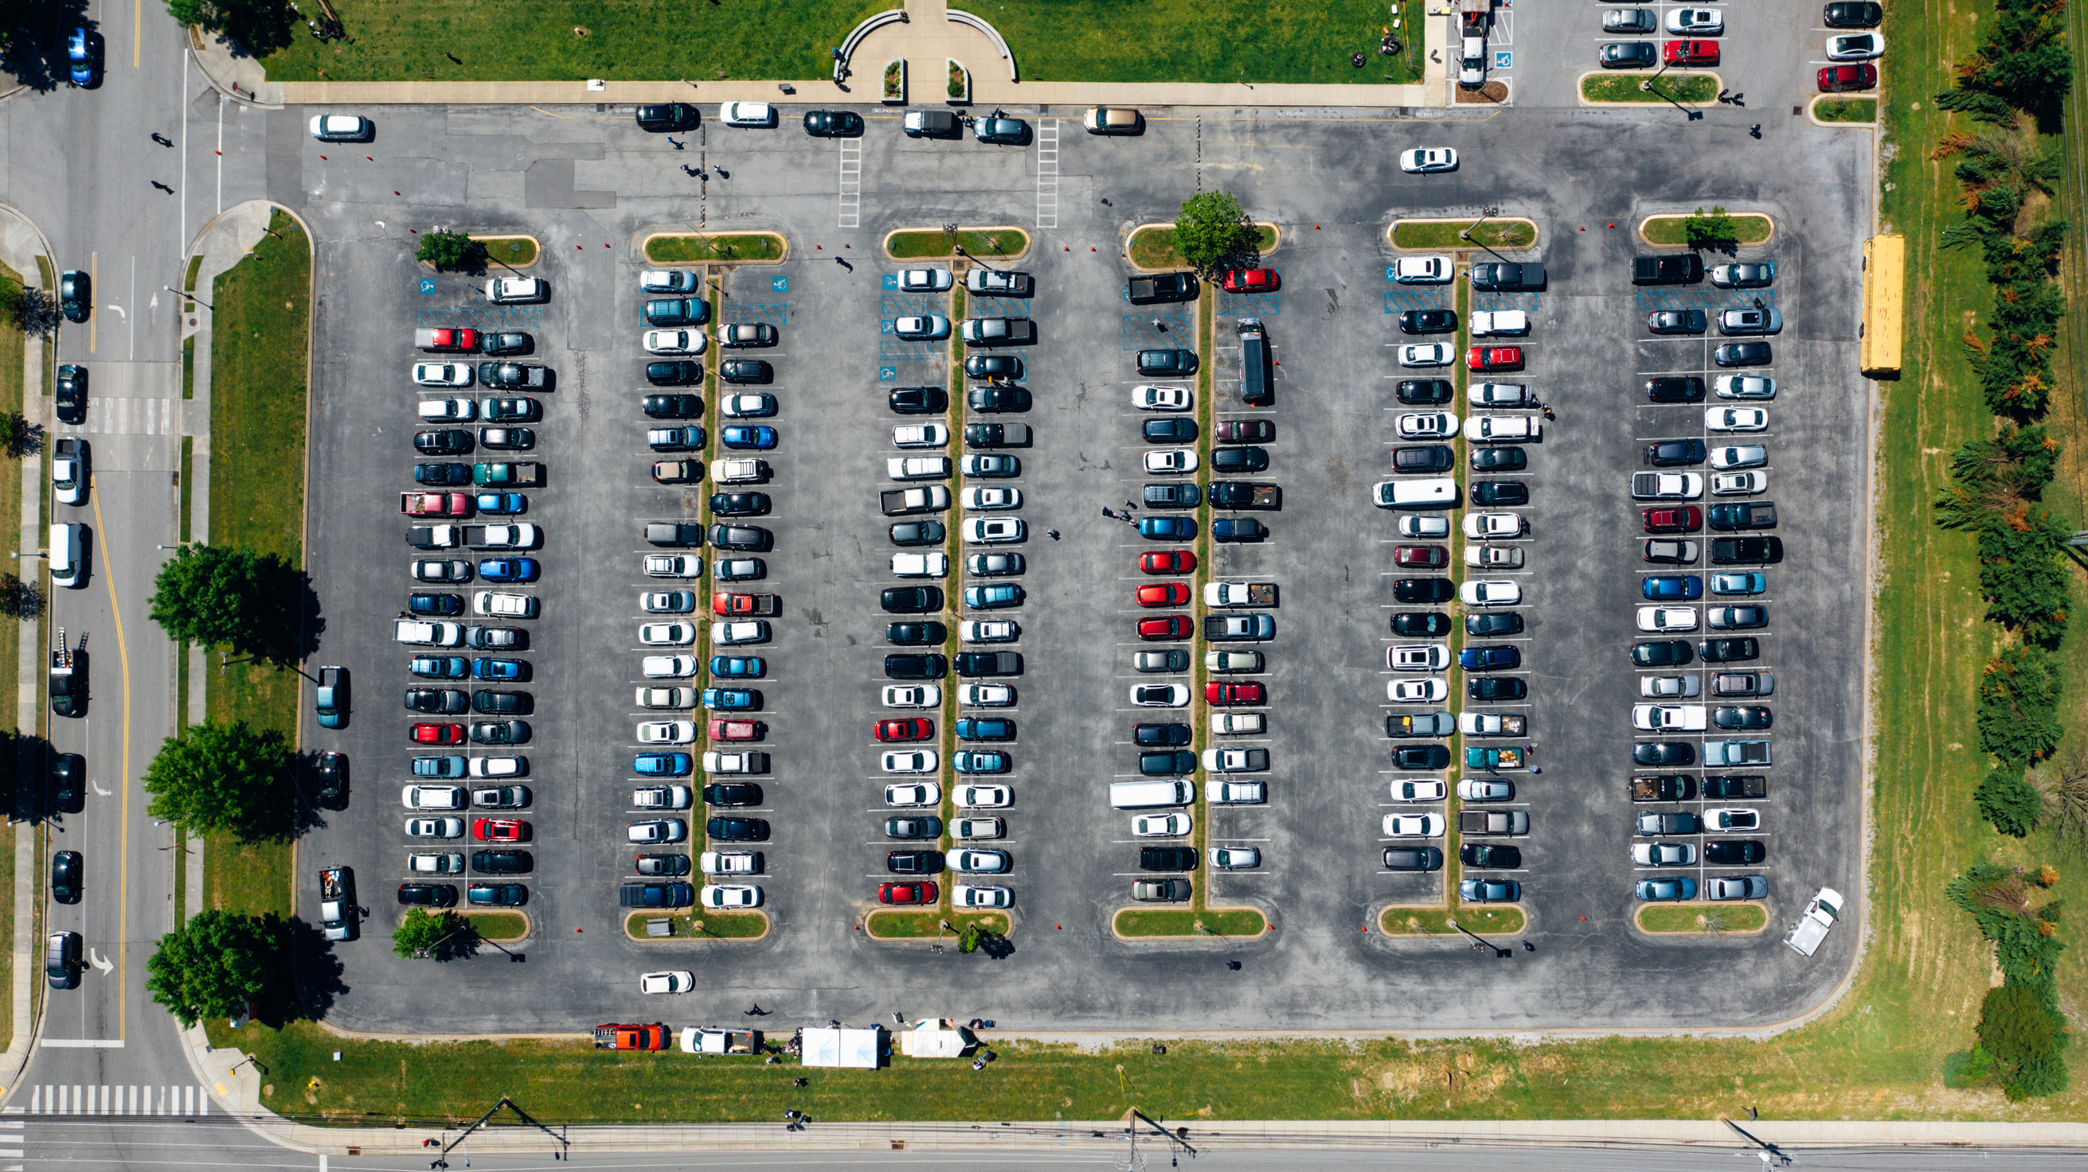
CURRENT SITUATION
Underutilized parking lot during non-peak hours and weekends
Lack of automated check-in and check-out system
No CCTV cameras for security
Limited accessibility features

Slide 3
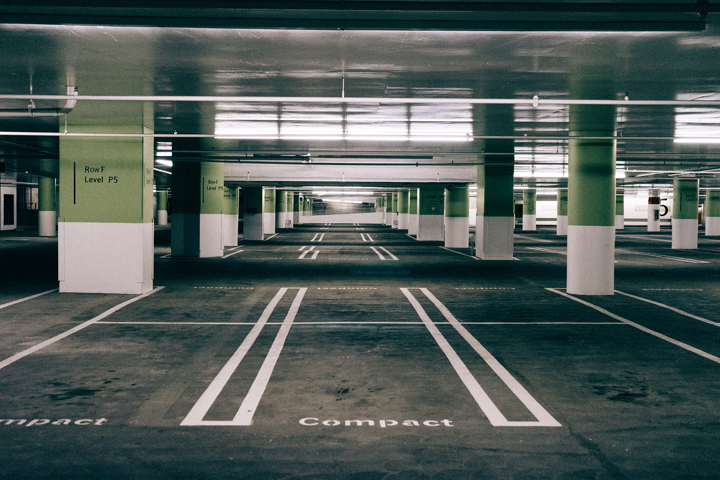
PROJECT OBJECTIVES
Monetize the parking space by making it accessible to the public during specified times
Ensure smooth operations and minimize disruptions to the company's daily activities
Enhance the customer experience by providing convenient and safe parking facilities

Slide 4
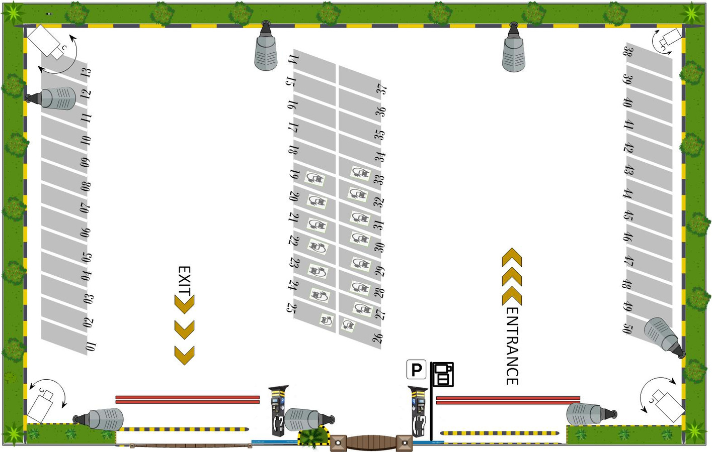
VISIO PROJECT FLOOR PLAN

Slide 5

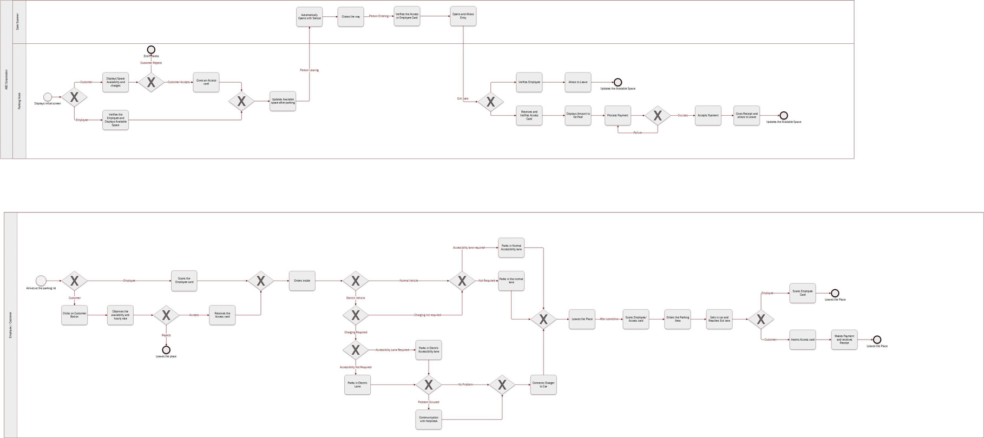
BUSINESS PROCESS MODEL AND NOTATION (BPMN) DIAGRAM

Slide 6
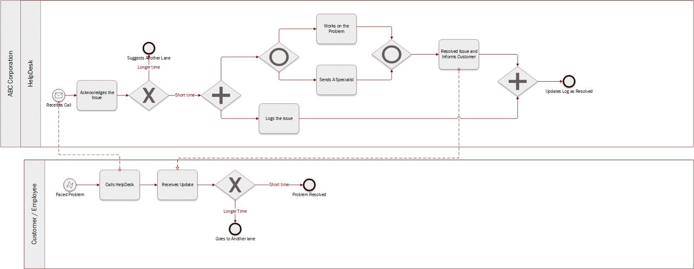
BUSINESS PROCESS MODEL AND NOTATION (BPMN) DIAGRAM

Slide 7
What will be the project timeline? Please share what will be tentative start and end date for the
project
PROJECT TIMELINE

Slide 8
RESOURCE& MATERIALS
INSERT RESOURCE SHEET
How many resources are required? What are the hourly charges for those resources?
What all material is required

Slide 9

CONSLUSION

